Slide 1
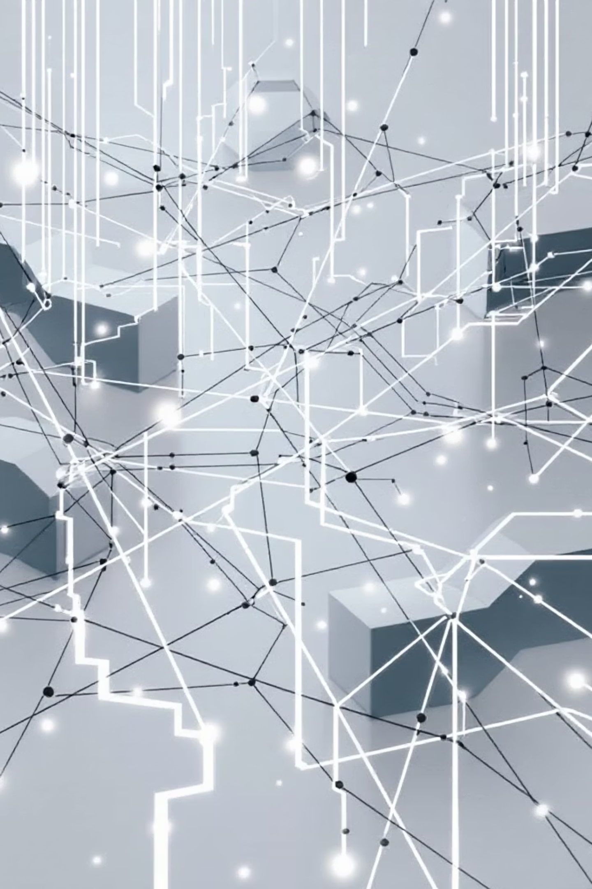
The Dark Side of the Internet
The internet has revolutionized communication, education, and business. However, it also has a dark side that poses serious threats to individuals, organizations, and society. This document explores the hidden dangers lurking online.

Slide 2

1. Cybercrime
Cybercrime is one of the biggest threats on the internet.
Type
Description
Hacking
Unauthorized access to systems and data
Phishing
Fake emails/websites to steal personal info
Ransomware
Malware that locks files until ransom is paid
Identity Theft
Stealing personal data for fraud
Financial Fraud
Online banking scams and credit card theft
💡 Fact: Cybercrime is expected to cost the world $10.5 trillion annually by 2025 (Cybersecurity Ventures).

Slide 3

2. The Dark Web
The Dark Web is a hidden part of the internet that requires special software (like Tor) to access.
What happens on the Dark Web?
❌ Illegal marketplaces
❌ Sale of stolen data
❌ Weapons and drug trafficking
❌ Hiring of illegal services
✅ But also used by journalists and activists for privacy protection

Slide 4
3. Cyberbullying & Online Harassment
43% of internet users have experienced online harassment
Platforms like social media are common places for:
Trolling
Hate speech
Threats and intimidation
Doxxing (exposing personal info)
Impact:
Depression and anxiety
Social isolation
In extreme cases, self-harm or suicide

Slide 5
4. Misinformation & Fake News
The spread of false information is a growing concern.
How it spreads:
Consequences:
Social media algorithms
Bots and fake accounts
Clickbait headlines
Deepfake videos
Public confusion
Political manipulation
Health misinformation (e.g., during pandemics)
Erosion of trust in media

Slide 6
5. Privacy Invasion
Who is watching you?
🏢 Corporations
🏛️ Governments
collect and sell your data
mass surveillance programs
🕵️ Hackers
📱 Apps
steal personal information
track location, contacts, and habits
Common Privacy Threats:
Data harvesting
Cookies and trackers
Unauthorized access to cameras/microphones
Social engineering attacks

Slide 7

6. Online Addiction
Types of Internet Addiction:
📱 Social media addiction
🎮 Gaming addiction
🛒 Online shopping addiction
📺 Binge-watching/streaming addiction
Effects:
Sleep deprivation
Poor academic/work performance
Relationship problems
Mental health issues

Slide 8
7. Exploitation of Vulnerable Groups
Children targeted by online predators
Human trafficking facilitated through the internet
Exploitation of elderly through scams
Recruitment into extremist groups

Slide 9
How to Stay Safe Online
01
02
Use strong, unique passwords for each account
Enable two-factor authentication (2FA)
03
04
Be cautious of suspicious links and emails
Keep software updated regularly
05
06
Use a VPN for secure browsing
Limit personal information shared online
07
08
Educate children about online safety
Report suspicious or harmful content
09
10
Use antivirus software
Think before you click or share

Slide 10
📊 Statistics
Statistic
Data
Cybercrime cost (2025 est.)
$10.5 Trillion/year
Data breaches (2023)
2,800+ reported
People affected by cyberbullying
43% of users
Daily phishing emails sent
3.4 Billion
Average time to detect a breach
197 days
The internet is a powerful tool, but it comes with serious risks. Being aware, educated, and cautious is the first step toward protecting yourself and others from the dark side of the internet.
The internet is a great place to learn, connect, and grow — but only if we use it responsibly.
📎 References
Cybersecurity Ventures Report
Pew Research Center
FBI Internet Crime Report
Norton Cybersecurity Insights

